Slide 1



BLOOD CELL SUBTYPE IDENTIFIER
By
Pradeeshwaran R
Ramesh R

Slide 2
INTRODUCTION
  Blood cell analysis is an important part of medical diagnosis.
  Manual examination of microscopic blood-smear images can require significant time and expertise.
  Different white blood cell (WBC) subtypes have different morphological characteristics.
  Image processing and deep learning can assist in automatically identifying these cell types.
  This project develops an automated system for WBC subtype classification and cell detection.
02

Slide 3

PROBLEM STATEMENT
Manual identification of white blood cell subtypes from microscopic images can be time-consuming and depends on expert observation.
The project addresses the need for an automated image-based system that can:
  Detect cell-like regions from a blood-cell image.
  Identify the WBC subtype automatically.
  Classify cells into four major subtypes.
  Provide the number of detected cells.
  Display the detected cells with their predicted labels.
Four target subtypes:
Eosinophil | Lymphocyte | Monocyte | Neutrophil
reallygreatsite.com
03

Slide 4
OBJECTIVES
To develop an automated computer-vision and deep-learning system for identifying WBC subtypes from microscopic images.
  To prepare and process the blood-cell image dataset.
  To extract meaningful visual features from blood-cell images.
  To classify WBCs into four subtypes.
  To detect individual cell-like regions in an uploaded image.
  To predict the subtype of each detected region.
reallygreatsite.com
04

Slide 5
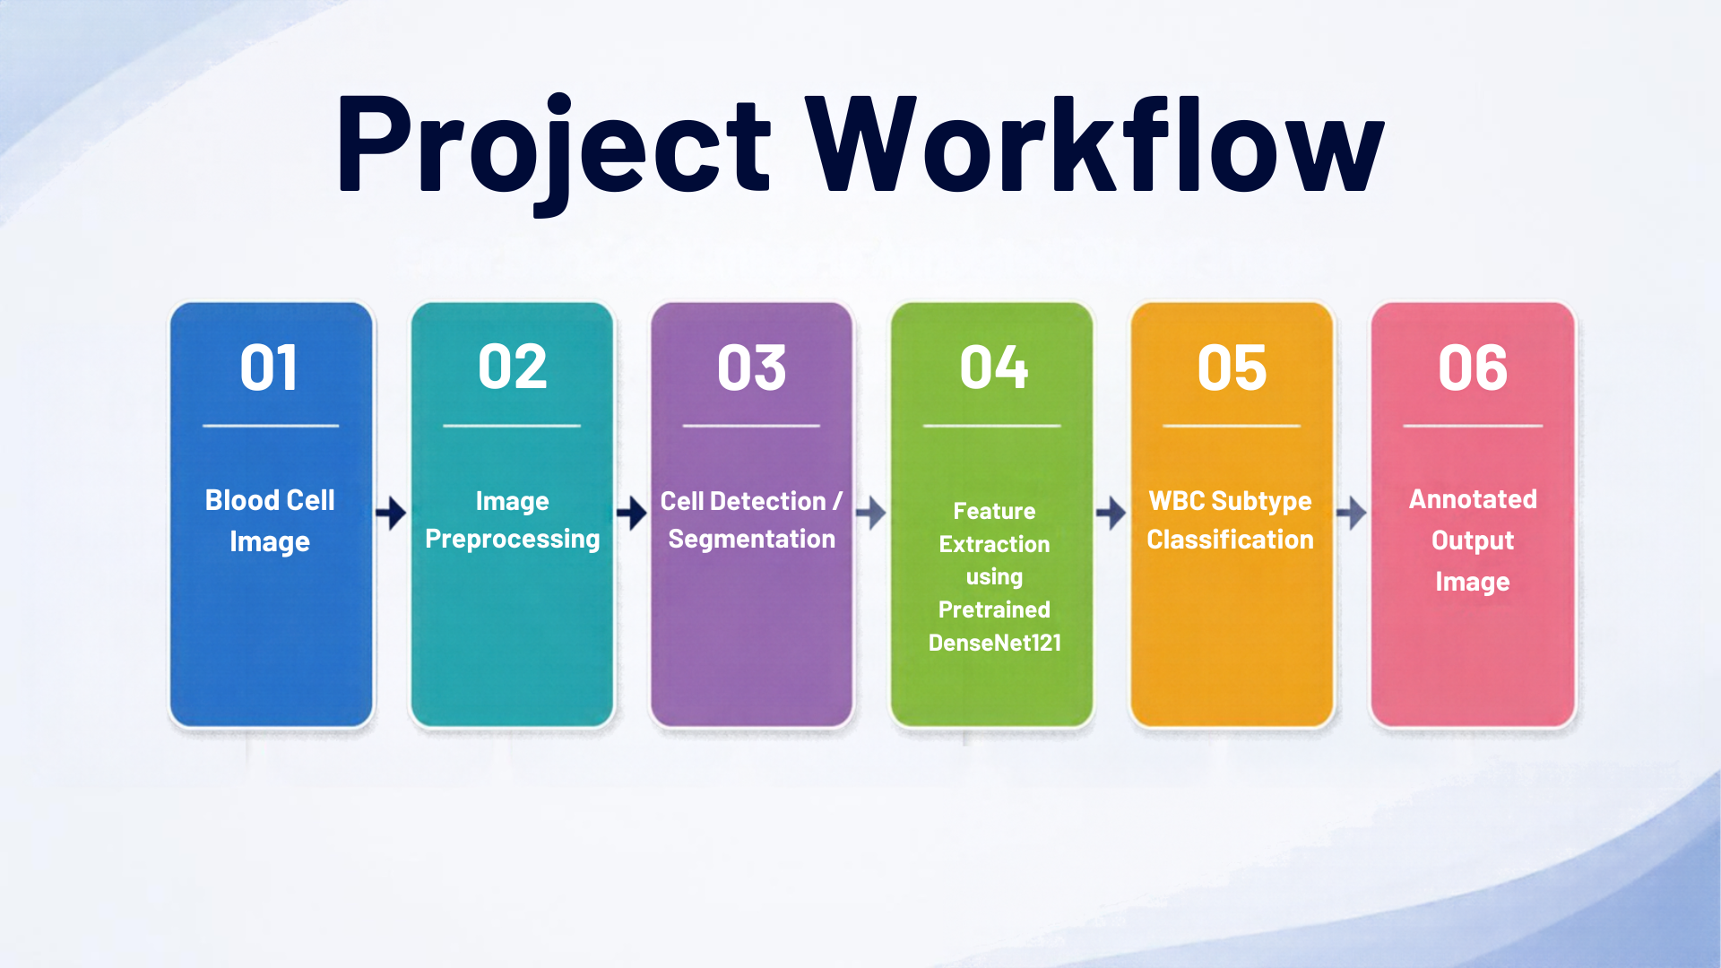

Slide 6
METODHOLOGY
01.
Dataset Preparation:The blood-cell dataset is loaded, separated into training and testing images, and prepared for processing.
02.
Feature Extraction:Pretrained DenseNet121 is used to extract important visual features from the blood-cell images.
03.
Feature Extraction:Pretrained DenseNet121 is used to extract important visual features from the blood-cell images.
06

Slide 7
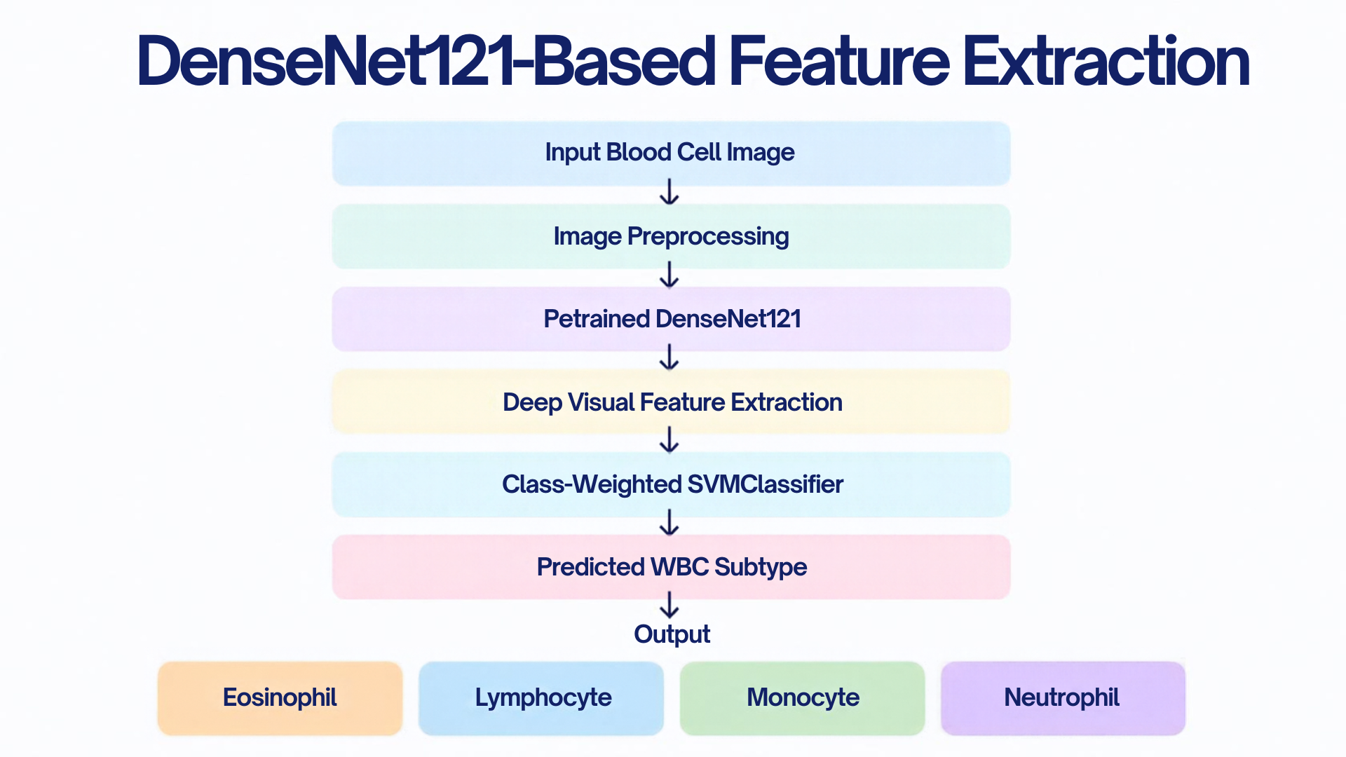
07

Slide 8
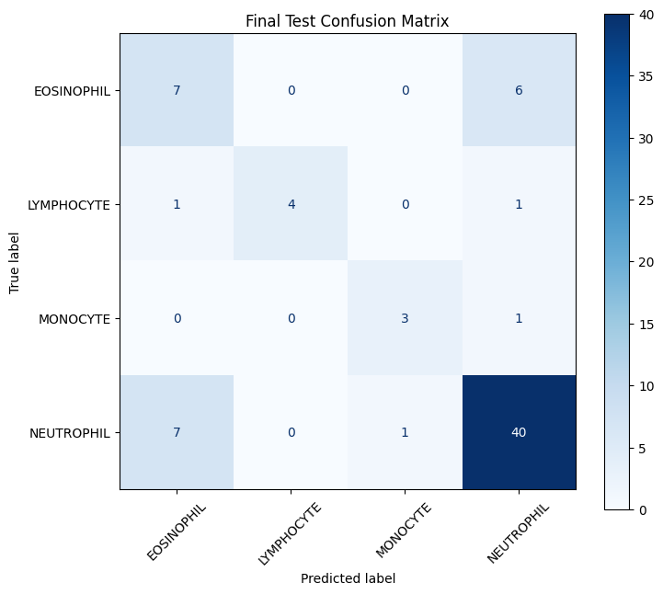
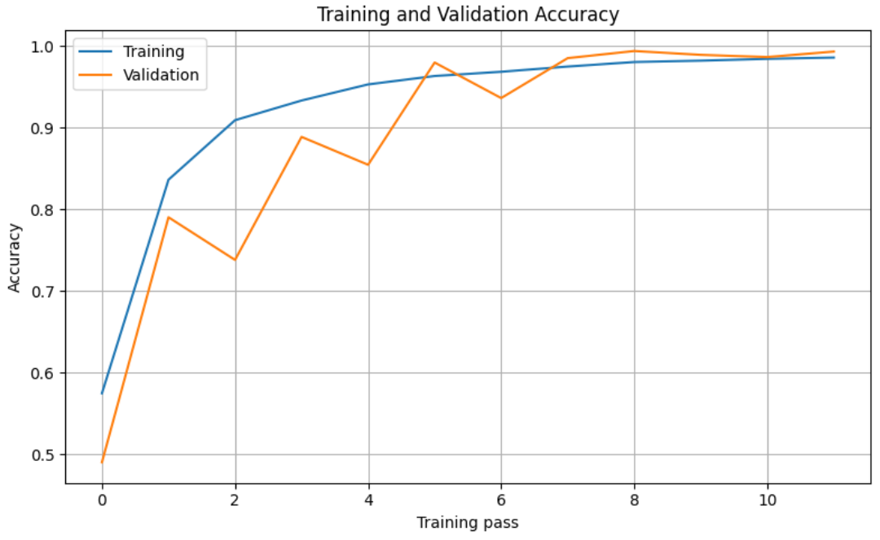
08

Slide 9
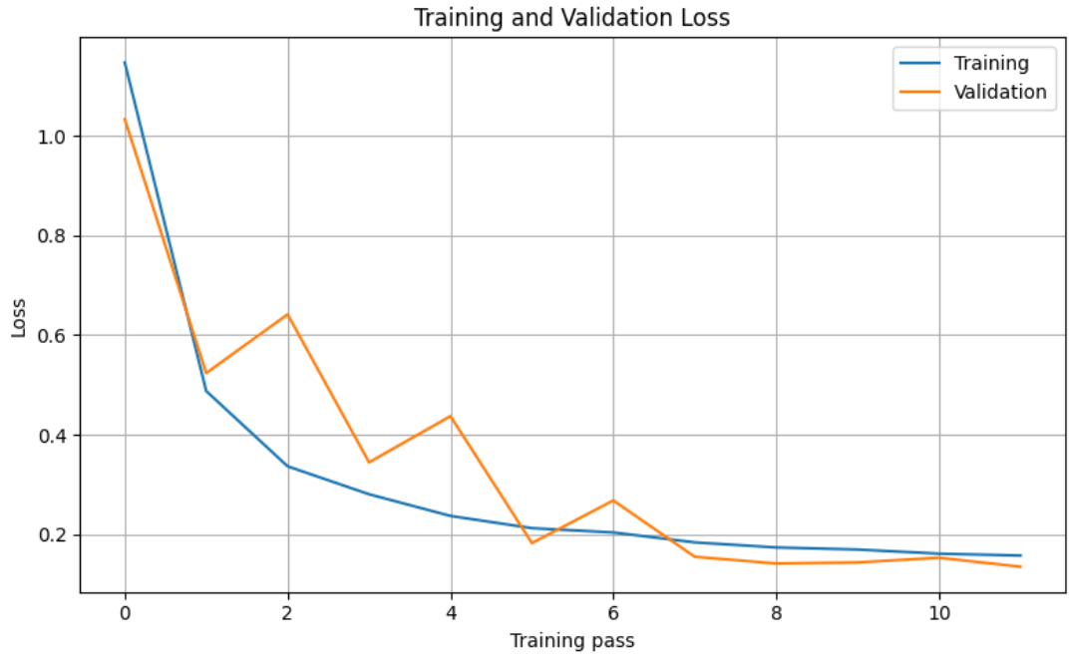
09

Slide 10
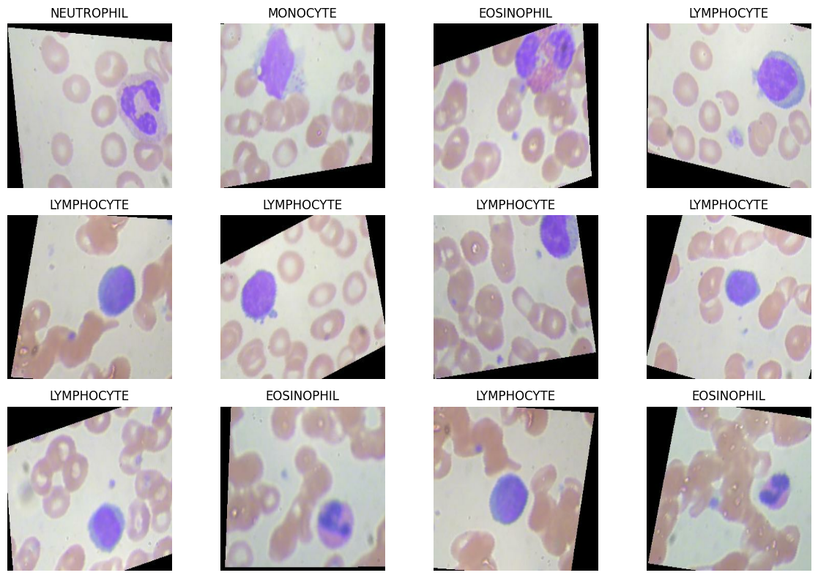
10

Slide 11
ADVANTAGES
LIMITATIONS
  Automated WBC subtype identification.
  Reduces dependence on completely manual inspection.
  Produces an annotated image for easy interpretation.
  Uses pretrained deep-learning features.
  Require more initial set up time
  The subtype model is trained for four WBC classes only.
  It is not trained to classify RBCs or platelets.
  Cell counting depends on the quality of image segmentation.
reallygreatsite.com
11

Slide 12
FUTURE SCOPE
  Add more blood-cell classes.
  Develop separate RBC and platelet classification.
  Improve overlapping-cell detection.
  Use larger and more diverse datasets.
  Develop a user-friendly web/mobile interface.
09

Slide 13
THANK YOU

